Slide 1

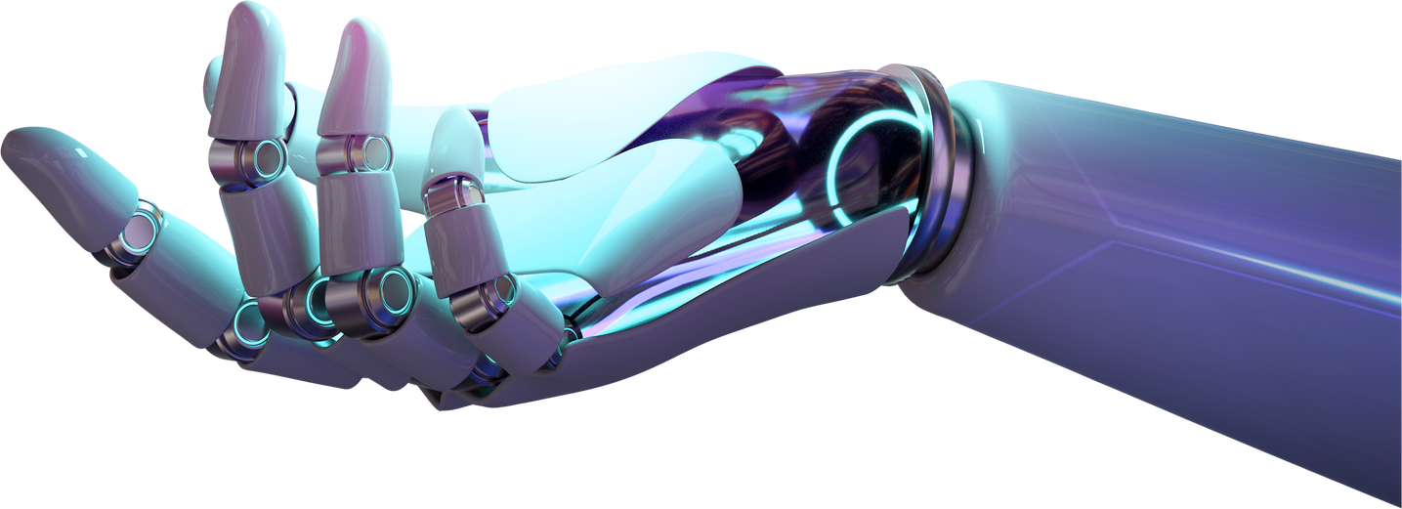
Paniergo
Home
About
Content
Others
UNDERSTANDING KNOWLEDGE REPRESENTATION
ARTIFICIAL INTELLIGENCE
Art
Read More
Paniergo
-
Knowledge Representation
-
Page 01

Slide 2


Paniergo
Home
About
Content
Others
INTRODUCTION
The term artificial intelligence (AI) describes how machines mimic human thought processes.
Among these techniques are:
Learning
Perception
Reasoning
Action
To allow AI systems to store and use knowledge efficiently, knowledge representation is essential.
Paniergo
-
Knowledge Representation
-
Page 02

Slide 3
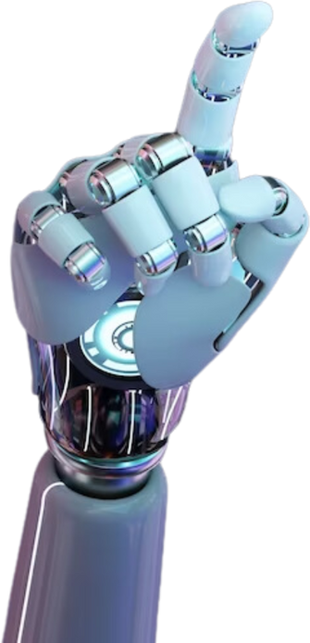
Paniergo
Home
About
Content
Others
TYPES OF
KNOWLEDGE REPRESENTATION
Forms of Knowledge Representation
Semantic Networks: Graph structures representing knowledge in terms of entities and their relationships
Frames: Data structures for representing stereotypical situations
Ontologies: Formal representations of a set of concepts within a domain and the relationships between them.
Paniergo
-
Knowledge Representation
-
Page 03

Slide 4
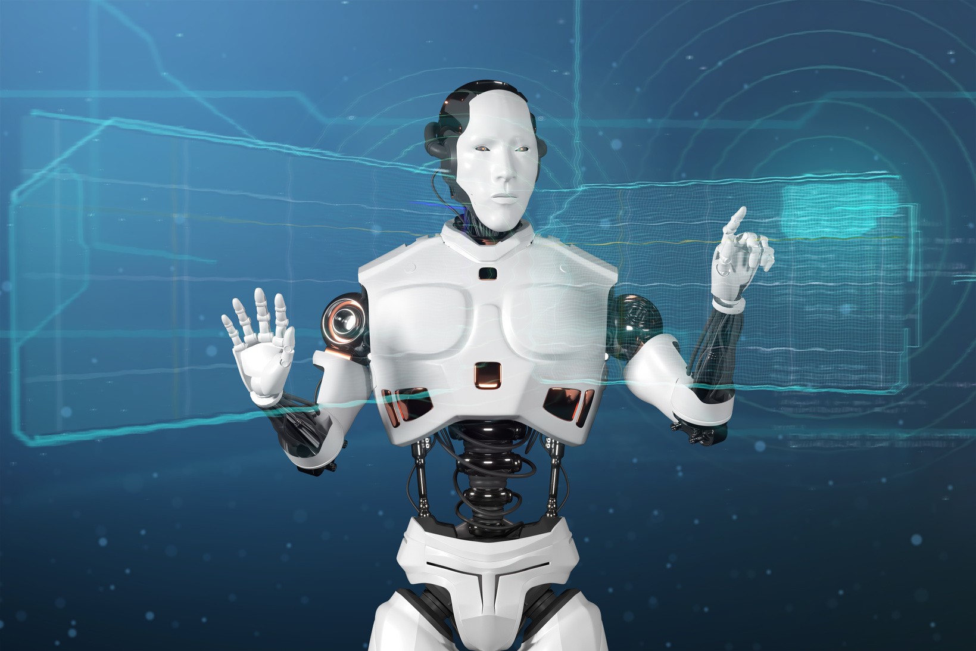
Paniergo
Home
About
Content
Others
CASE STUDY
MEDICAL DIAGNOSIS
To diagnose, treat, and understand symptoms, knowledge representation is employed.
An illustration of a tool:
Ontologies: Define the connections between illnesses, symptoms, and therapies using ontologies.
Rule-based Systems: Deduce diagnoses using conditional rules.
Paniergo
-
Knowledge Representation
-
Page 04

Slide 5
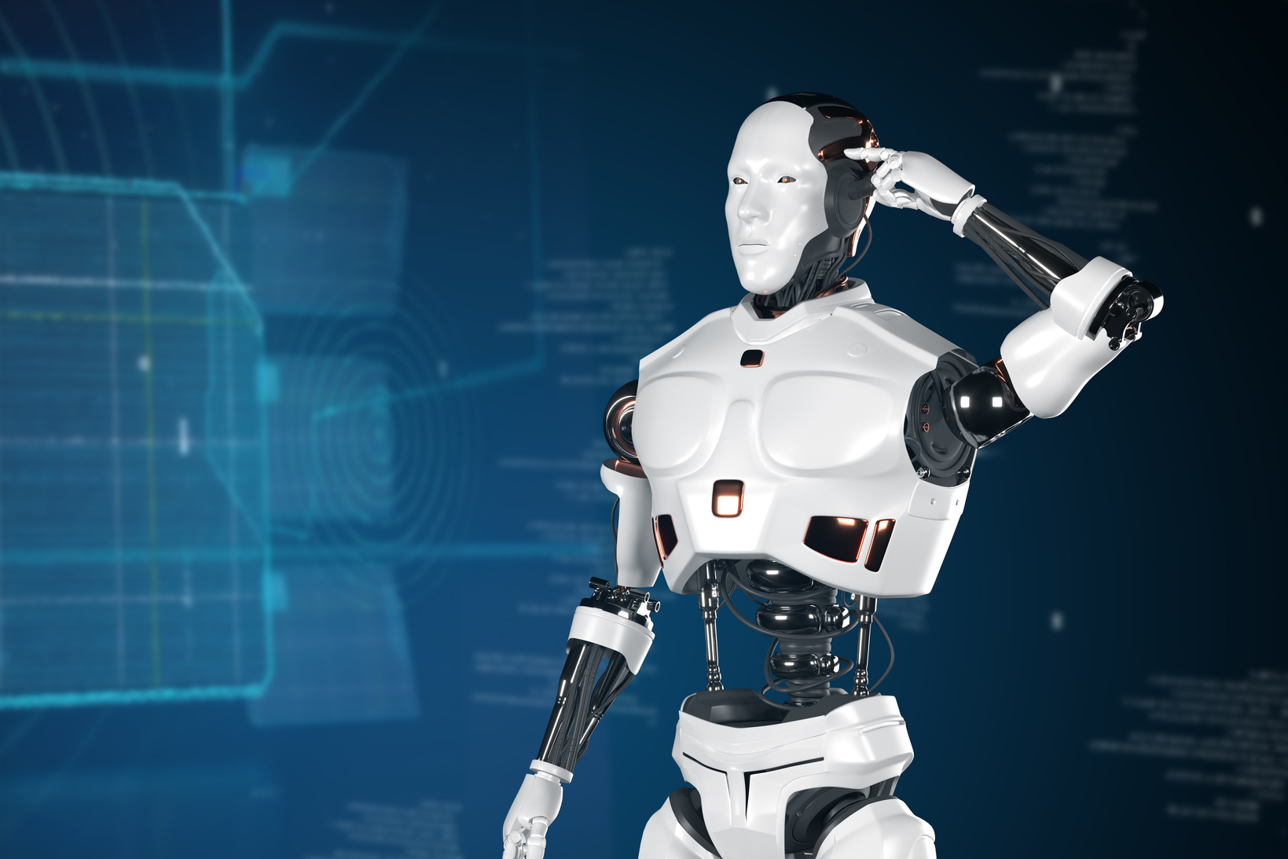
Paniergo
Home
About
Content
Others
KNOWLEDGE REPRESENTATION MODEL
Simple Problem Selected: Diagnosing a common cold vs. flu based on symptoms.
Knowledge Representation Model Created: Type Used: Semantic Network illustrating symptoms and conditions.Nodes: Symptoms (e.g., cough, fever), Conditions (cold, flu).
Edges: Relationships indicating which symptoms are associated with which conditions.
How the Model Works:Allows the AI system to infer the most likely condition based on observed symptoms.
Visual Suggestion: Diagram of the semantic network with nodes and connections.
Paniergo
-
Knowledge Representation
-
Page 05

Slide 6
Paniergo
Home
About
Content
Others
CONCLUSION
Summary of Key Points:Knowledge representation is vital for effective AI functioning.
Different forms (semantic networks, frames, ontologies) serve unique purposes in processing information.
Real-world applications like medical diagnosis highlight the importance of structured knowledge representation.
Reflection on Learning:Gained insights into how knowledge representation enhances AI capabilities and decision-making processes.
Visual Suggestion: A concluding graphic that encapsulates the importance of knowledge representation in AI.
Paniergo
-
Knowledge Representation
-
Page 06

Slide 7


Paniergo
Home
About
Content
Others
CONTACT
(+63) 9053180014
markcristhian.paniergo@gmail.com
https://github.com/mclangstrong/CSST101-CS3A
Sta Cruz, Laguna
Paniergo
-
Knowledge Representation
-
Page 07

Slide 8
Paniergo
Home
About
Content
Others
THANK YOU
KNOWLEDGE REPRESENTATION PRESENTATION
Paniergo
-
Knowledge Representation
-
Page 08

